Slide 1
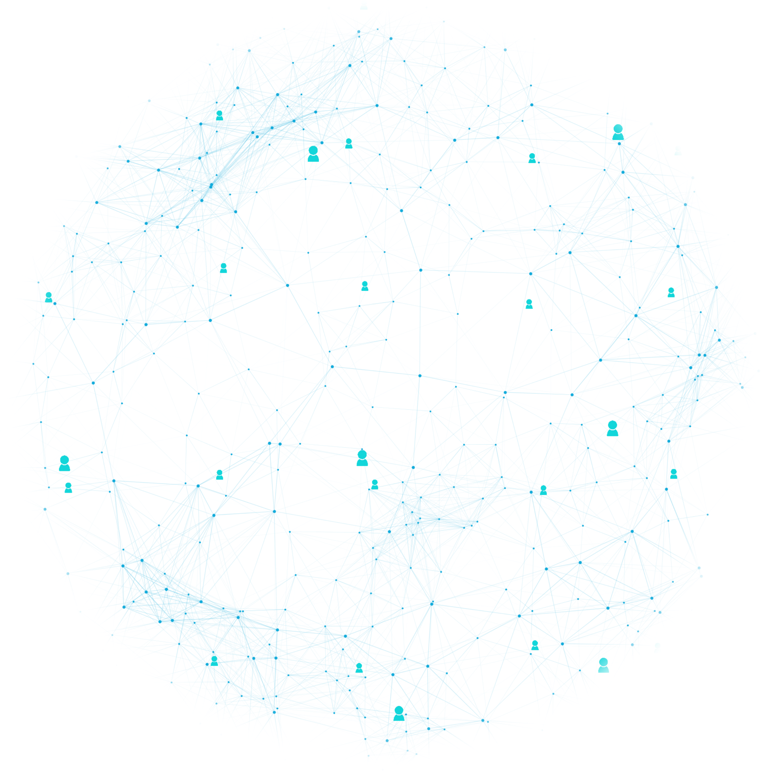

RAVEN
Connecting Communities for Safer Streets

Slide 2

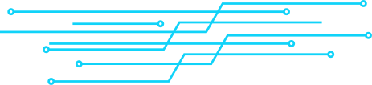




Team Members & Responsibilities
ANKIT SUBHAMJYOTI
Cloud Automation and Database management , wanted criminal detection system
SURAJ KUMAR SAHU
Integration of Geofencing Technology and Live Interaction System
LUCKY KUMAR SWAIN
Live Authentication and Complain System with Interactive User Interface

Slide 3

Problem Statement
Inadequacies in online crime reporting systems, lacking anonymous submissions, live video uploads, and real-time location sharing that severely hinder law enforcement, causing delays and risking crucial evidence loss during investigations.

Slide 4




Solution
Our project leverages cutting-edge technology and user-friendly features to empower communities and law enforcement agencies. We are developing a system for anonymous submissions, a wanted criminal detection system, live location sharing, real-time video uploads, geofencing, and a live interaction system.
Our system ensures swift and efficient communication between users and authorities and efficiently identifies and tracks wanted criminals. Instantly analyzing uploaded images or videos, this advanced technology empowers law enforcement, offering a potent tool for effective incident response and the apprehension of individuals of interest by implementing robust cybersecurity measures to safeguard user data.

Slide 5









Flow Chart / Graphical Representation
Live Video Conversation With An Policer Officer In Case Of Any Emergency, For Example Road Accident
Nearest Police Van
Sharing Live Location & Live Video Footage
POLICE
Database
Mobile Application
Database
Web Application Development
Police Station

Slide 6

Identified Cybersecurity Challenges
Deficiency in evidential documentation within complaint submissions, compromising the integrity of reported incidents.
Vulnerability due to the absence of a secure and streamlined process for anonymous reporting, risking confidentiality and hindering threat identification.
Critical gap in real-time evidence gathering through the lack of live video upload functionality, impeding immediate response and analysis of ongoing cyber incidents.
Delay in sharing live locations with law enforcement, potentially jeopardizing swift mitigation of cyber threats and impeding proactive measures against ongoing attacks.

Slide 7

Security Measures
Ensuring Confidentiality, Integrity, and Availability
1. Data Security Measures
Encryption : To guarantee the security of sensitive data, we implement robust encryption protocols. All user information, including unique identification codes and personal details, is encrypted using cryptographic techniques. This ensures that unauthorized access to the data is prevented, maintaining the confidentiality of user information.

Slide 8

Security Measures
2. Database Security using AWS
Cloud Provider : We have chosen Amazon Web Services (AWS) as our cloud provider to ensure the utmost security for our database.

Slide 9

Security Measures
3. CIA Triad Implementation:
A. Confidentiality
Unique Identification Code : Each citizen is assigned a 12-digit AlphaNumeric Unique Identification (UID) Code. This code is the only piece of information visible to local authorities, ensuring the confidentiality of the user's identity.
Centralized Database : User data, linked to the 12-digit UID Code, is stored in a central database with no local access. This centralized approach prevents unauthorized access at the local level, reinforcing confidentiality.
Data Retrieval for False Reporting : In the event of false reporting, the data can be accessed by higher authorities with the appropriate permissions to take necessary actions. This ensures accountability and maintains the integrity of the reporting system.

Slide 10

Security Measures
3. CIA Triad Implementation:
B. Integrity
Strong Encryption : Data integrity is preserved through the implementation of strong encryption methods. This safeguards against unauthorized modifications or tampering, maintaining the accuracy and trustworthiness of the stored information.
AWS Security Standards : Leveraging AWS services further strengthens the integrity of our data by adhering to stringent security standards set by a globally recognized cloud service provider.

Slide 11

Security Measures
3. CIA Triad Implementation:
C. Availability
Data Redundancy : Live video footage, a critical component of our system, is stored in multiple locations for enhanced availability. This includes the central database, local police stations, and on users' devices. This redundancy ensures that the data is accessible and recoverable in the event of any system failures or unforeseen incidents.
In summary, our security measures are designed to not only meet but exceed industry standards. By prioritizing the CIA Triad and implementing advanced security practices, we are committed to building a secure and reliable crime reporting system that instills confidence in both users and law enforcement authorities.

Slide 12
Framework
Mobile Application
FLUTTER : A framework that enables the development of mobile applications in Dart language.
Application Backend
Node.js : A JavaScript runtime for building server-side applications.
Express.js : A web application framework for Node.js, providing a robust set of features for web and mobile applications.

Slide 13

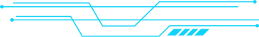
App Features
1. Anonymous Reporting
Enable users to submit crime reports anonymously, ensuring the protection of their privacy and encouraging a higher level of community participation in providing information

Slide 14
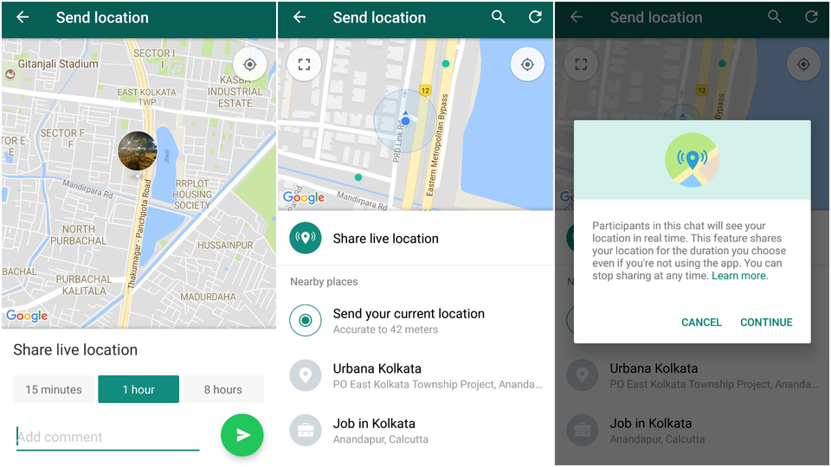

2. Live Location Sharing
3. Geofencing for Proximity Alerts
Empower users to share their real-time location with law enforcement and patrol vehicles, enabling a swift response to incidents and enhancing overall public safety
Utilize geofencing technology to notify nearby police stations and patrol vehicles of incidents, optimizing coordination and response speed for law enforcement.

Slide 15


4. Real-time Video Submission
5. Live Interaction System
Facilitate real-time video uploads, allowing users to promptly submit critical evidence, thereby streamlining and expediting the investigative process.
Integrate a live interaction system featuring video calls and chat functionalities for emergency situations, promoting effective real-time communication between users and authorities.

Slide 16

conclusion
Our team is dedicated to addressing the shortcomings in current crime reporting systems by leveraging technology to enhance public safety. Through the development of this app-based solution, we aim to contribute to the efficiency of law enforcement agencies, ultimately fostering a safer and more secure society. By embracing innovation and collaboration, our team is committed to making a positive impact on our community and realizing a future where technology plays a pivotal role in the pursuit of justice.

Slide 17

RAVEN
Thank
you!

